Slide 1
Decision Trees (Wrap-up) and Random Forest Classifier
CSN-382

Slide 2
Plan for today
Wrap-up the discussion of decision trees
How to learn decision trees from training data

Slide 3





Constructing Decision Trees
Given some training data, what’s the “optimal” DT?
5
How to decide which rules to test for and in what order?
NO
YES
$$x_{1}>3.5 ?$$
4
NO
YES
NO
YES
How to assess informativeness of a rule?
3
$$x_{2}>2 ?$$
$$x_{2}>3 ?$$
Feature 2 ($x_{2})$
2
Predict Red
Predict Green
Predict Green
Predict Red
1
In general, constructing DT is an intractable problem (NP-hard)
1
2
3
4
5
6
Feature 1 ($x_{1})$
The rules are organized in the DT such that most informative rules are tested first
Often we can use some “greedy” heuristics to construct a “good” DT
Hmm.. So DTs are like the “20 questions” game (ask the most useful questions first)
To do so, we use the training data to figure out which rules should be tested at each node
Informativeness of a rule is of related to the extent of the purity of the split arising due to that rule. More informative rules yield more pure splits
The same rules will be applied on the test inputs to route them along the tree until they reach some leaf node where the prediction is made

Slide 4
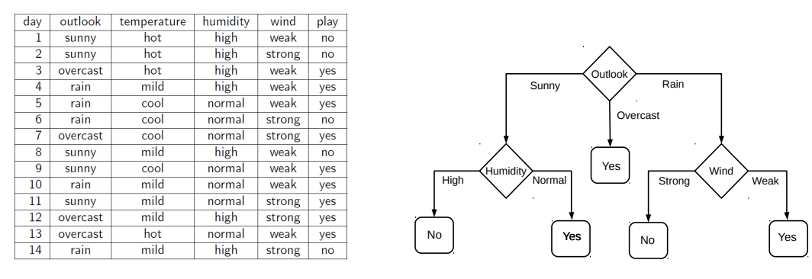
Decision Tree Construction: An Example
4
Let’s consider the playing Tennis example
Assume each internal node will test the value of one of the features
Question: Why does it make more sense to test the feature “outlook” first?
Answer: Of all the 4 features, it’s the most informative
It has the highest information gain as the root node

Slide 5
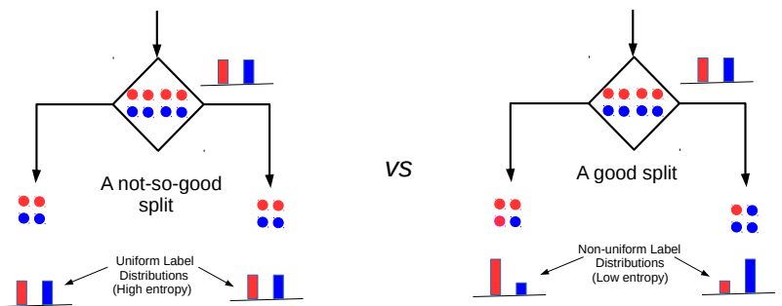


Entropy and Information Gain
5
Assume a set of labelled inputs $S$ from C classes, $p_{c}$ as fraction of class c inputs
Entropy of the set $S$ is defined as $H(S)=−\sum_{c∈C}{p_{c} log p_{c}}$
Suppose a rule splits $S$ into two smaller disjoint sets $S_{1}$ and $S_{2}$
Reduction in entropy after the split is called information gain
Uniform sets (all classes roughly equally present) have high entropy; skewed sets low
$IG=H\left(S\right)− \frac{\left|S_{1}\right|}{\left|S\right|}H\left(S_{1}\right)$ $− \frac{\left|S_{2}\right|}{\left|S\right|}H\left(S_{2}\right)$
This split has a low IG
(in fact zero IG)
This split has higher IG

Slide 6
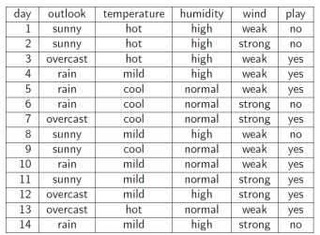
Entropy and Information Gain
6
Let’s use IG based criterion to construct a DT for the Tennis example
At root node, let’s compute IG of each of the 4 features
Consider feature “wind”. Root contains all examples S = [9+,5-]
S_{weak} = [6+, 2−] ⇒ H(S_{weak} ) = 0.811
S_{strong} = [3+, 3−] ⇒ H(S_{strong}) = 1
Likewise, at root: IG(S, outlook) = 0.246, IG(S, humidity) = 0.151, IG(S,temp) = 0.029
Thus we choose “outlook” feature to be tested at the root node
Now how to grow the DT, i.e., what to do at the next level? Which feature to test next?
Rule: Iterate - for each child node, select the feature with the highest IG
$$\text{H}\text{(}\text{S} \text{) =}\text{ −(9/14) }\text{log}\text{2}\text{(9/14) − (5/14) }\text{lo}\text{g}\text{2}\text{(5/14) = 0.94}$$
$IG(S,wind)=H\left(S\right)− \frac{\left|S_{weak}\right|}{\left|S\right|}H\left(S_{weak}\right)$ $− \frac{\left|S_{strong}\right|}{\left|S\right|}H\left(S_{strong}\right)$ = 0.94 − 8/14 ∗ 0.811 − 6/14 ∗ 1 = 0.048

Slide 7
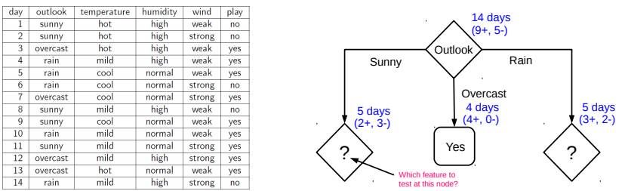
Growing the tree
7
Proceeding as before, for level 2, left node, we can verify that
IG(S,temp) = 0.570, IG(S, humidity) = 0.970, IG(S, wind) = 0.019
Thus humidity chosen as the feature to be tested at level 2, left node
No need to expand the middle node (already “pure” - all “yes” training examples ☺)
Can also verify that wind has the largest IG for the right node
Note: If a feature has already been tested along a path earlier, we don’t consider it again

Slide 8
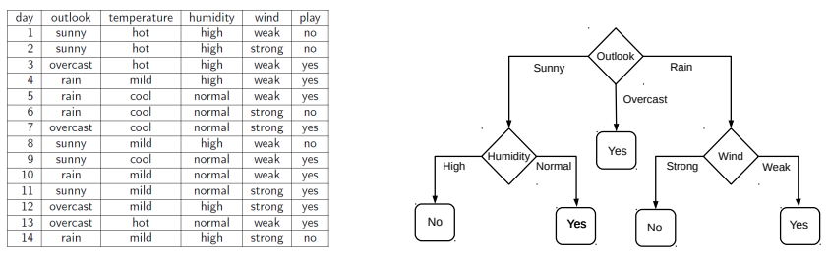
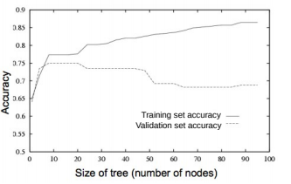
When to stop growing the tree?
8
Stop expanding a node further (i.e., make it a leaf node) when
It consist of all training examples having the same label (the node becomes “pure”)
We run out of features to test along the path to that node
The DT starts to overfit (can be checked by monitoring
the validation set accuracy)
Important: No need to obsess too much for purity
It is okay to have a leaf node that is not fully pure, e.g., this
At test inputs that reach an impure leaf, can predict probability of belonging to each class (in above example, p(red) = 3/8, p(green) = 5/8), or simply predict the majority label
To help prevent the tree from growing too much!
OR

Slide 9
Avoiding Overfitting in DTs
9
Desired: a DT that is not too big in size, yet fits the training data reasonably
Note: An example of a very simple DT is “decision-stump”
A decision-stump only tests the value of a single feature (or a simple rule)
Not very powerful in itself but often used in large ensembles of decision stumps
Mainly two approaches to prune a complex DT
Prune while building the tree (stopping early)
Prune after building the tree (post-pruning)
Criteria for judging which nodes could potentially be pruned
Use a validation set (separate from the training set)
Prune each possible node that doesn’t hurt the accuracy on the validation set
Greedily remove the node that improves the validation accuracy the most
Stop when the validation set accuracy starts worsening
Use model complexity control, such as Minimum Description Length (will see later)
Either can be done using a validation set

Slide 10
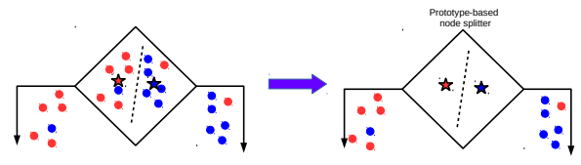
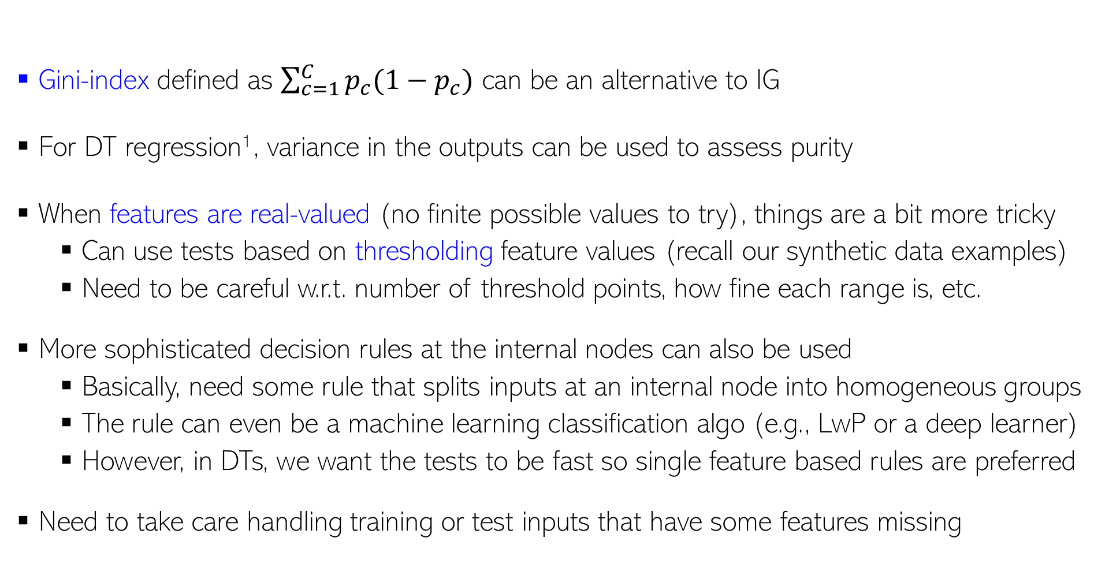
Decision Trees: Some Comments
For regression, outputs are real-valued and we don’t have a “set” of classes, so quantities like entropy/IG/gini etc. are undefined
10
Gini-index defined as $\sum_{c=1}^{C}{p_{c}(1−p_{c})}$ can be an alternative to IG
For DT regression¹, variance in the outputs can be used to assess purity
When features are real-valued (no finite possible values to try), things are a bit more tricky
Can use tests based on thresholding feature values (recall our synthetic data examples)
Need to be careful w.r.t. number of threshold points, how fine each range is, etc.
More sophisticated decision rules at the internal nodes can also be used
Basically, need some rule that splits inputs at an internal node into homogeneous groups
The rule can even be a machine learning classification algo (e.g., LwP or a deep learner)
However, in DTs, we want the tests to be fast so single feature based rules are preferred
Need to take care handling training or test inputs that have some features missing
An illustration on the next slide
¹Breiman, Leo; Friedman, J. H.; Olshen, R. A.; Stone, C. J. (1984). Classification and regression trees

Slide 11
An Illustration: DT with Real-Valued Features
11
Test example
“Best” (purest possible) Horizontal Split
“Best”(purest possible) Vertical Split
Up Down
Left Right
Between the best horizontal vs best vertical split, the vertical split is better (more pure), hence we use this rule for the internal node
This illustration’s credit: Purushottam Kar

Slide 12
Decision Trees: A Summary
12
.. thus helping us learn complex rule as a combination of several simpler rules
Some key strengths:
Simple and easy to interpret
Nice example of “divide and conquer”
paradigm in machine learning
Easily handle different types of
features (real, categorical, etc.)
Very fast at test time
Multiple DTs can be combined
via ensemble methods: more powerful
(e.g., Decision Forests; will see later)
Used in several real-world ML applications, e.g., recommender systems, gaming (Kinect)
Some key weaknesses:
Learning optimal DT is (NP-hard) intractable. Existing algos mostly greedy heuristics
Can sometimes become very complex unless some pruning is applied
5
NO
YES
$$x_{1}>3.5 ?$$
4
NO
YES
NO
YES
3
$$x_{2}>2 ?$$
$$x_{2}>3 ?$$
Feature 2 ($x_{2})$
2
Predict Red
Predict Green
Predict Green
Predict Red
1
1
2
3
4
5
6
Human-body pose estimation
Feature 1 ($x_{1})$

Slide 13
Random Forest Classifier
Random Forest is a popular machine learning algorithm that belongs to the supervised learning technique. It can be used for both Classification and Regression problems in ML. It is based on the concept of ensemble learning, which is a process of combining multiple classifiers to solve a complex problem and to improve the performance of the model.
Random Forest is a classifier that contains a number of decision trees on various subsets of the given dataset and takes the average to improve the predictive accuracy of that dataset. Instead of relying on one decision tree, the random forest takes the prediction from each tree and based on the majority votes of predictions, and it predicts the final output.
The greater number of trees in the forest leads to higher accuracy and prevents the problem of overfitting.
The individual decision trees tend to overfit to the training data but random forest can mitigate that issue by averaging the prediction results from different trees. This gives random forests a higher predictive accuracy than a single decision tree.

Slide 14
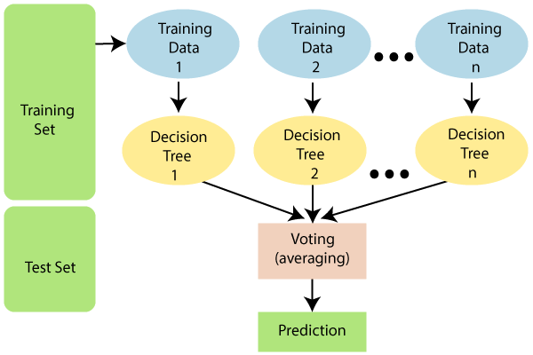
Random Forest Classifier
Random Forest works in two-phase first is to create the random forest by combining N decision tree, and second is to make predictions for each tree created in the first phase.
The Working process can be explained in the below steps and diagram:
Step-1: Select random K data points from the training set.
Step-2: Build the decision tree (DT) associated with the selected data points (Subset of training set).
Step-3: Choose the number n (total number of DTs) for decision forest that you want to build.
Step-4: Repeat Step 1 & 2 (n times) to create n DTs.
Step-5: For new data points, find the predictions of each decision tree, and assign the new data points to the category that wins the majority votes.

Slide 15
Ensemble ML Algorithms
Most real life systems that use ML use not one but several models
Known to be true of industrial models for recommendation, search, ranking
Ensemble: a collection of several ML models working cooperatively
Ensembles have several advantages
Reduce reliance on a single model which may fail at times
Allow us to harness the strengths of a variety of models
Offers users a smooth transition if ensemble needs modification (increase the modularity of system)
E.g. if an outdated algorithm is removed from ensemble or a latest algorithm is added
If a single model had been used, changing that model could disrupt user experience
Can also be used to address bias-variance issues
Some ensemble techniques can lower bias of weak models (make them more powerful)
Other techniques can lower variance of models (make them stable and less jittery)
Will see bias-variance in detail later

Slide 16






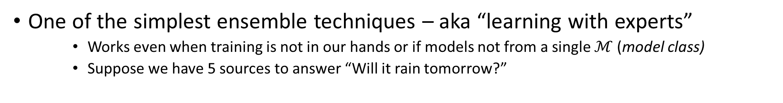
Voting Ensemble
No individual news network gets more than 66% correct predictions but if we take a majority vote, we are 100% correct all the time. The same trick is also popularly used in psephology (“poll of polls”)
One of the simplest ensemble techniques – aka “learning with experts”
Works even when training is not in our hands or if models not from a single $ℳ$(model class)
Suppose we have 5 sources to answer “Will it rain tomorrow?”
P
Gold Truth
Correct prediction
Q
N
N
Y
N
Y
Y
Y
Y
Y
Y
N
N
N
N
N
Y
Y
N
Y
N
Y
N
Y
Y
Y
Y
Y
Y
N
N
Y
N
Y
Y
Y
N
Incorrect prediction

Slide 17


Voting Ensembles
Receive $K$ pre-trained classifiers $f_{1},f_{2},…,f_{K}$ s.t. $f_{i}:𝒳→\left\{−1,+1\right\}$
Construct a new classifier ${\hat{f}}_{MAJ}$ such that for any $x∈𝒳$ ${\hat{f}}_{MAJ}\left(x\right)=sign\left(\sum_{k=1}^{K}{f_{k}\left(x\right)}\right)$
Hope that mistakes of one classifier will be corrected by others
Need to ensure experts are diverse so that they can correct each other’s errors. Bagging and boosting take direct steps to ensure this

Slide 18
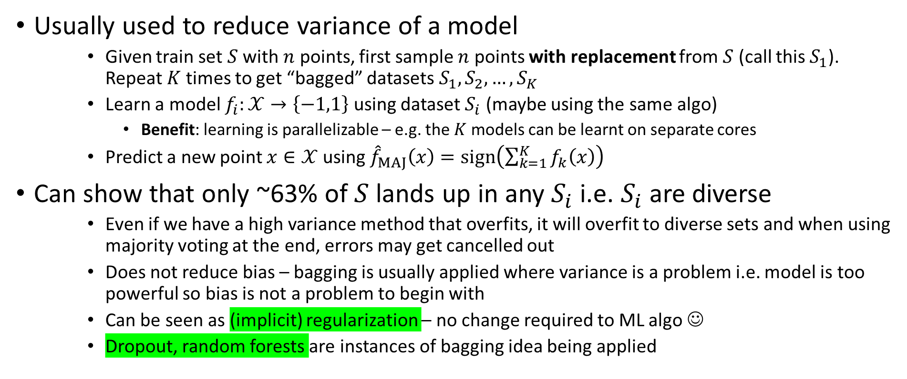
Bagging – Bootstrap AGGregatING
Usually used to reduce variance of a model
Given train set $S$ with $n$ points, first sample $n$ points with replacement from $S$ (call this $S_{1}$). Repeat $K$ times to get “bagged” datasets $S_{1},S_{2},…,S_{K}$
Learn a model $f_{i}:𝒳→\left\{−1,1\right\}$ using dataset $S_{i}$ (maybe using the same algo)
Benefit: learning is parallelizable – e.g. the $K$ models can be learnt on separate cores
Predict a new point $x∈𝒳$ using ${\hat{f}}_{MAJ}\left(x\right)=sign\left(\sum_{k=1}^{K}{f_{k}\left(x\right)}\right)$
Can show that only ~63% of $S$ lands up in any $S_{i}$ i.e. $S_{i}$ are diverse
Even if we have a high variance method that overfits, it will overfit to diverse sets and when using majority voting at the end, errors may get cancelled out
Does not reduce bias – bagging is usually applied where variance is a problem i.e. model is too powerful so bias is not a problem to begin with
Can be seen as (implicit) regularization – no change required to ML algo ☺
Dropout, random forests are instances of bagging idea being applied

Slide 19
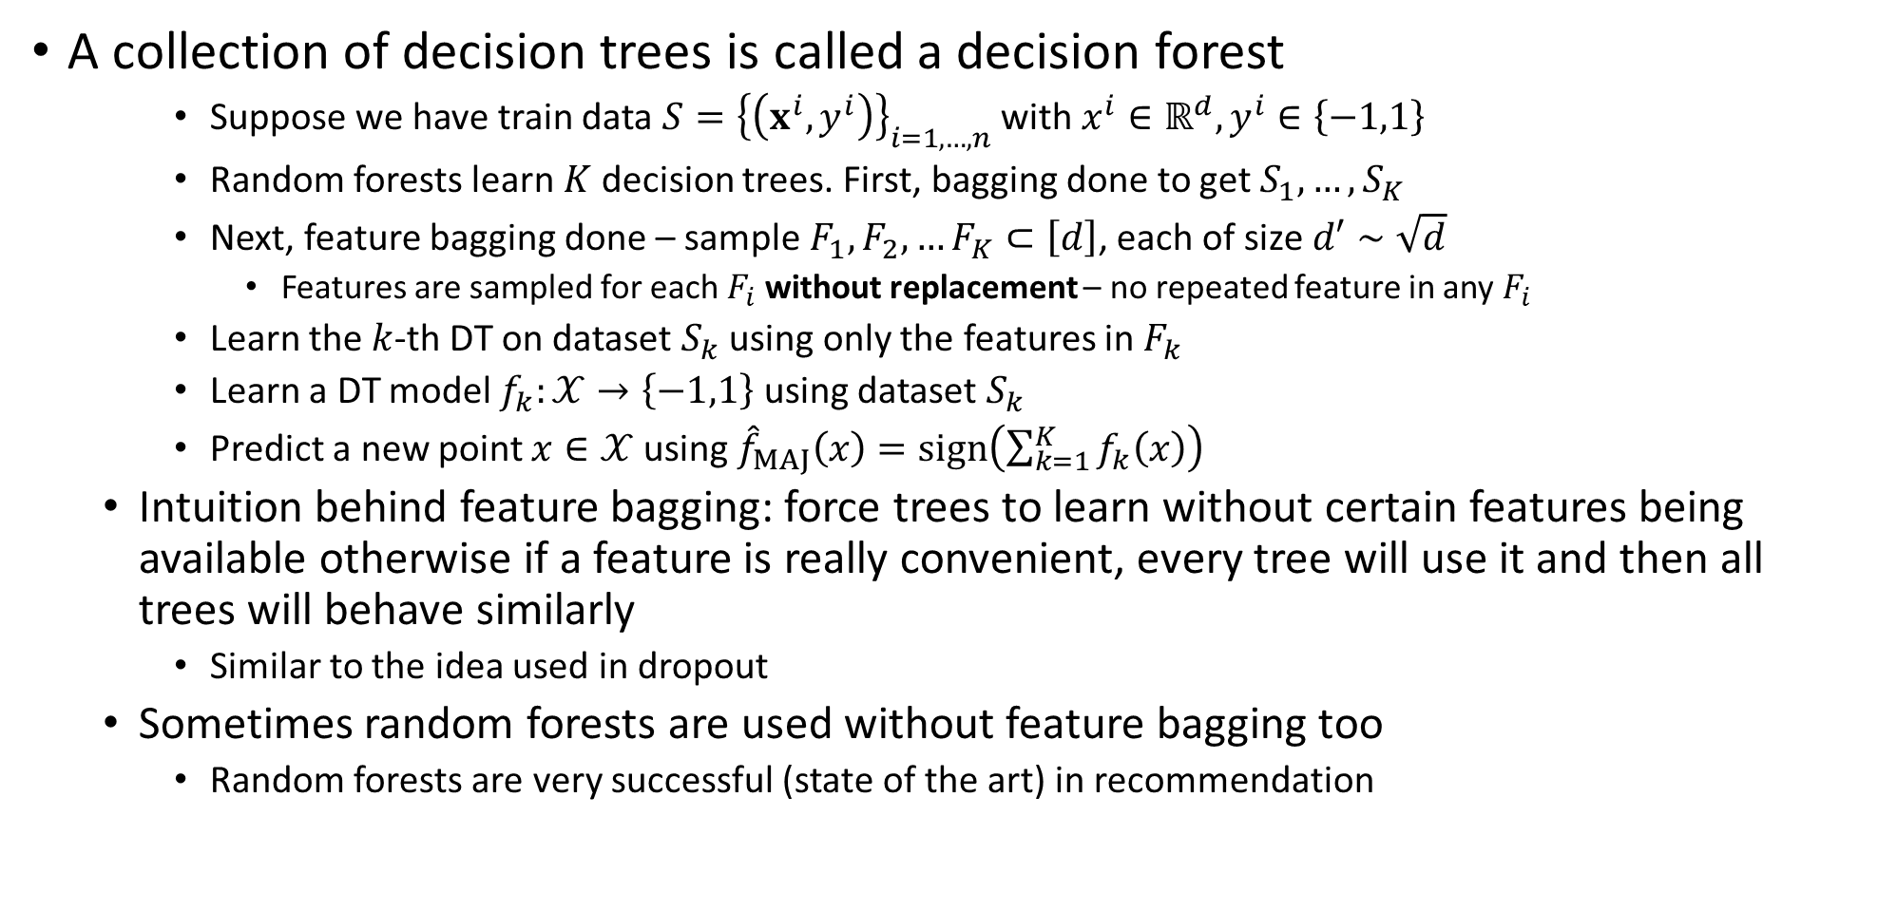
Random Forests
A collection of decision trees is called a decision forest
Suppose we have train data $S={\left\{\left(x^{i},y^{i}\right)\right\}}_{i=1,…,n}$ with $x^{i}∈ℝ^{d},y^{i}∈\left\{−1,1\right\}$
Random forests learn $K$ decision trees. First, bagging done to get $S_{1},…,S_{K}$
Next, feature bagging done – sample $F_{1},F_{2},…F_{K}⊂\left[d\right]$, each of size $d′∼\sqrt{d}$
Features are sampled for each $F_{i}$ without replacement – no repeated feature in any $F_{i}$
Learn the $k$-th DT on dataset $S_{k}$ using only the features in $F_{k}$
Learn a DT model $f_{k}:𝒳→\left\{−1,1\right\}$ using dataset $S_{k}$
Predict a new point $x∈𝒳$ using ${\hat{f}}_{MAJ}\left(x\right)=sign\left(\sum_{k=1}^{K}{f_{k}\left(x\right)}\right)$
Intuition behind feature bagging: force trees to learn without certain features being available otherwise if a feature is really convenient, every tree will use it and then all trees will behave similarly
Similar to the idea used in dropout
Sometimes random forests are used without feature bagging too
Random forests are very successful (state of the art) in recommendation

